Slide 1
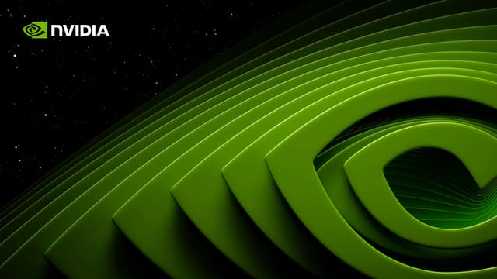
Threat Intelligence Report
By: Pragya Mittal, Yu-An Tsai, and James Volante

Slide 2
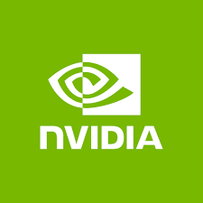
Introduction of NVIDIA
Multinational GPU Company
Impacts Various Industries
AI, Gaming, Autonomous Vehicles, and Robotics
Great Target for Intellectual Property, Financial Fraud, Geopolitics

Slide 3


Recon: Key NVIDIA Personnel
Camir Ricketts,
Employee with many active social media accounts
Jensen Huang, CEO of NVIDIA

Slide 4
Recon: NVIDIA IT Environment and Vulnerabilities
SAP ECC, SAP S/4HANA
HANA DB
Linux/Unix OS: Red Hat Enterprise Linux
Cloud services: Azure, AWS, GCP
Intel Vtune
CUDA

Slide 5
Assets
5 Assets that have identified to be the most important for NVIDIA:
NVIDIA Graphic Processing Unit (GPU) Intellectual Property (Specific): It includes the plans and schematics of their proprietary GPU.
Financial Systems (General): Unauthorized access could lead to financial and privacy losses.
Employee Database (General): Breach of employee data poses a risk for the company and opens it up to a privilege escalation attack.
Manufacturing Plants for NVIDIA's chips (Specific): NVIDIA, unauthorized access could disrupt the supply chain.
R&D Data (Specific): If stolen, other rival companies can use it to gain a strategic advantage over NVIDIA.

Slide 6
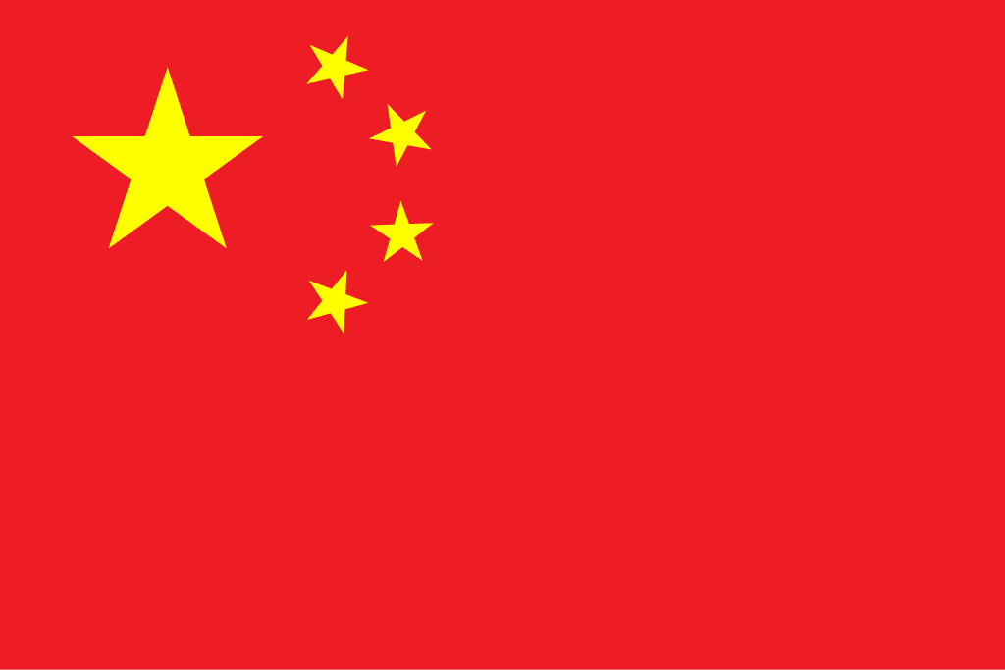
Attacker Profile for China
Actor Type: Nation State
Motive: Political
Skills: Known for sophisticated APT Activities, Huge Investment into Cyber
Scenario: Exploit IT Environment of NVIDIA
Notes:
The Chinese government will likely delegate the task of cyber attack to a state-sponsored cyber attack organization. Then the cyber attack organization would first scan NVIDIA's Internet to find open ports to infiltrate. They would then attempt to exploit known vulnerabilities in NVIDIA's IT environment, and further deploy malware to execute the exfiltration of confidential documents.

Slide 7
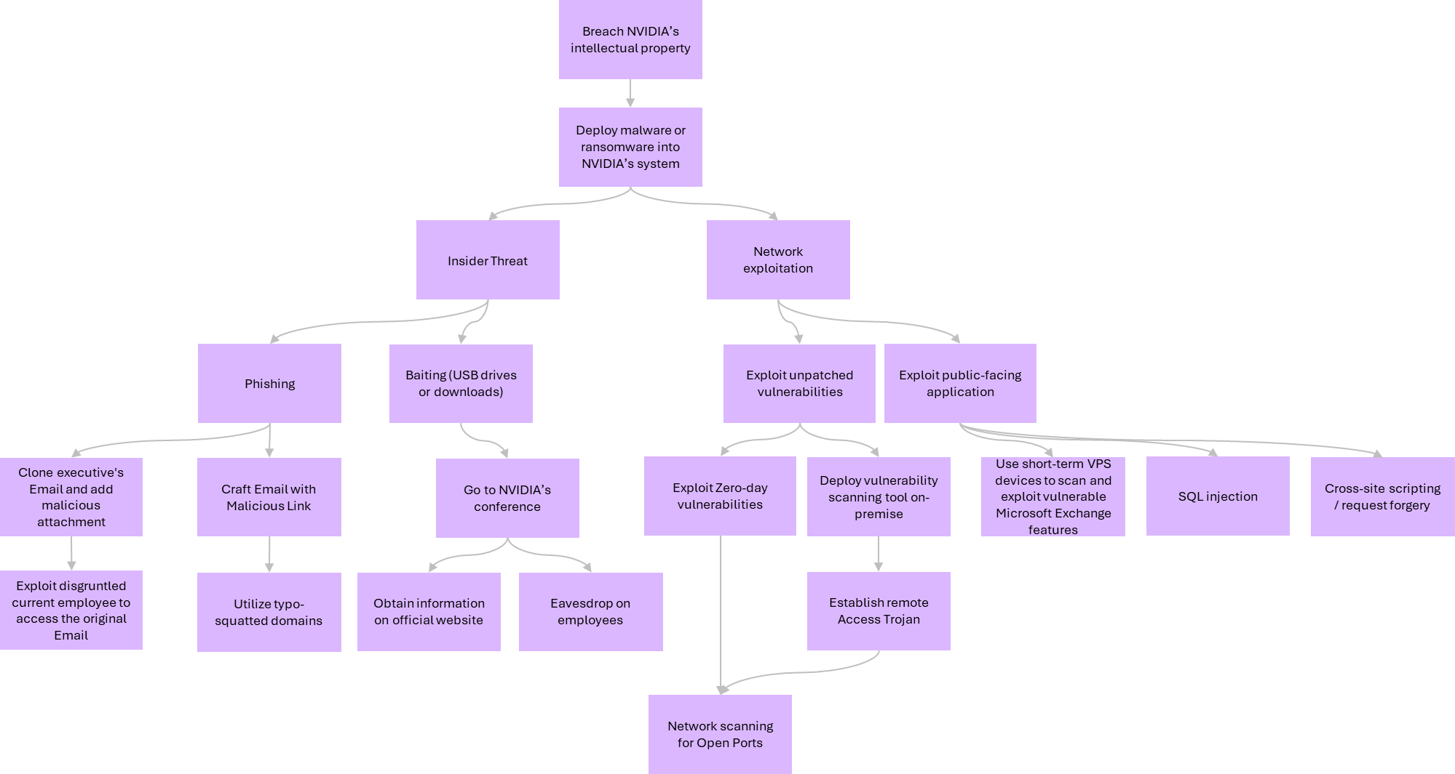
Attack Tree For China

Slide 8
Proposal: Threat intelligence Fusion Center
Attack surface:
Intellectual property
Supply Chain
Customer data
Threats:
APTs
Cybercriminals
Insider and Emerging Threats
Intelligence Requirements:
Identify threats to NVIDIA
Identify APT’s that would target NVIDIA
Identify threats to the NVIDIA supply chain
Notes:
Data sources and workflows, collaboration and reporting, tools and monitoring
IP - most valuable asset
Supply chain - operational financial
Customer data - reputation financial - lawsuits
Apts- nation state hackers china
Cybercriminals - hacker groups and hactivists over political or social issues
Insider and emerging - social engg, ai or quantum attacks
Generally plants are located in the outskirts of town, groups with intent to disrupt supply chain operations

Slide 9
Data Sources and Workflows
Threat Analysis Workflows:
Insider Threat Detection
TTP Identification
Vulnerability Monitoring
Strategic Analysis Workflows:
Competitor threats
Supply Chain risk assessment
Geopolitical risk assessment
Notes:
Insider Threat Detection - access control logs
TTP Identification - academic research papers
Apt tracking - isacs, government agencies like cisa
Vulnerability Monitoring - vulnerability databases
Supply Chain risk assessment - isacs
Geopolitical risk assessment - government agencies: cisa, dark web monitoring

Slide 10
Collaboration and Reporting Strategies
Roles and reporting:
Fusion Center Manager
Threat Intelligence Analyst
Incident Responder
Collaboration Partners:
Cyber Information Sharing and Collaboration Program
QIR Alliance
Suppliers and OEMs
Notes:
Fusion Center Manager - executive summary
Threat Intelligence Analyst - threat analysis reports
Incident Responder - incident response reports
Vulnerability Analyst - vulnerability report
CISCP - NVIDIA -nvidia could collaborate with CISA’s CISCP program or IT-ISAC to come up with sector-specific strategies against cyber attacks.
QIR Alliance - this is an organization NVIDIA is a part of that focuses on the development and standardization of quantum computing
Suppliers and OEMs - nvidia could also share intelligence with original equipment managers including Taiwan Semiconductor Manufacturing Company (TSMC) and Foxconn

Slide 11
Tools and Monitoring Activities
Elastisearch, Kibana & Logstash (ELK)
Duo Security
Teramind
SpyCloud
Suricata
Notes:
Elastisearch, Kibana & Logstash (ELK) - SIEM tool to monitor log and generate time-series analytics
Duo Security - this tool can be used to enforce access control and privilege management
Teramind - user behavior analytics tool - identify anomalous behaviour
SpyCloud - dark web
Suricata - ids, can set rules for incoming and outgoing traffic

